Slide 1
CH2PH2:
Chemical Kinetics
Dr. James Hallett
j.e.hallett@reading.ac.uk

Slide 2
Lecture 3
CH2PH2 Chemical Kinetics

Slide 3
michaelis-menten kinetics

Slide 4
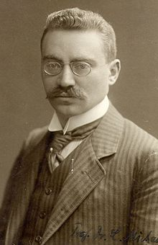
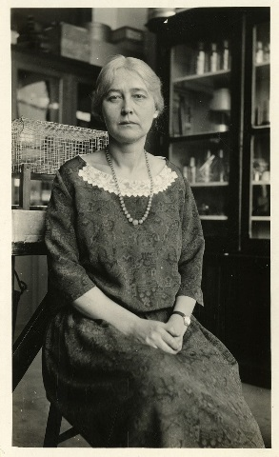
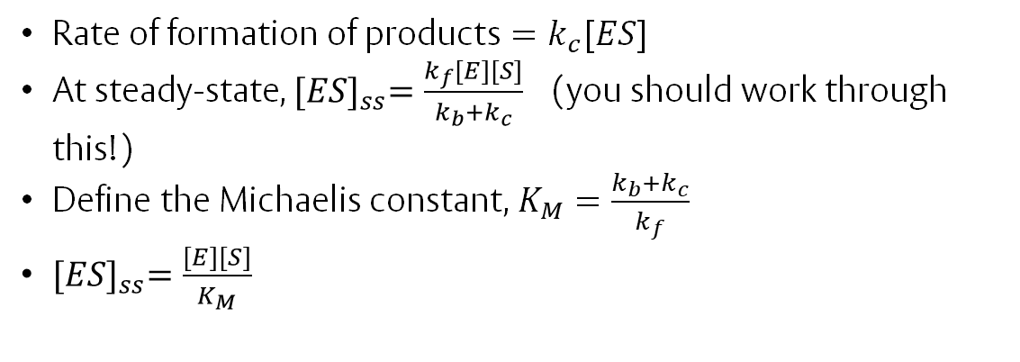
Michaelis-Menten Kinetics
Well-known scheme for enzyme catalysis
k_{f}
k_{c}
E + S
ES
E + P
k_{b}
Substrate
Products
Enzyme
Enzyme-Substrate
Complex
Leonor Michaelis
Maud Menten
Rate of formation of products $=k_{c}[ES]$
At steady-state, ${[ES]}_{ss}=\frac{k_{f}\left[E\right][S]}{k_{b}+k_{c}}$ (you should work through this!)
Define the Michaelis constant, $K_{M}=\frac{k_{b}+k_{c}}{k_{f}}$
${[ES]}_{ss}=\frac{\left[E\right][S]}{K_{M}}$

Slide 5
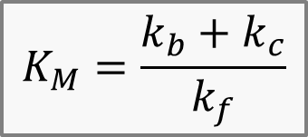
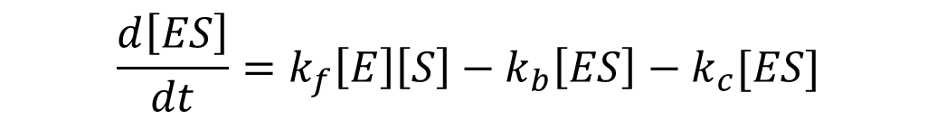

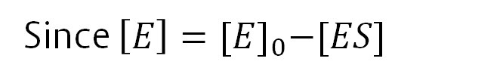
Michaelis-Menten Kinetics (cont)
$$\frac{d\left[ES\right]}{dt}=k_{f}\left[E\right]\left[S\right]−k_{b}\left[ES\right]−k_{c}[ES]$$
Since $\left[E\right]={[E]}_{0}−[ES]$
We have $0=k_{f}{[E]}_{0}\left[S\right]−k_{f}{\left[ES\right]}_{ss}\left[S\right]−k_{b}{\left[ES\right]}_{ss}−k_{c}{\left[ES\right]}_{ss}$
R$earranging, we have{ \left[ES\right]}_{ss}=\frac{k_{f}{\left[S\right]}_{0}{\left[E\right]}_{0}}{k_{f} {\left[S\right]}_{0}+k_{b}+k_{c}}=\frac{{\left[S\right]}_{0}{\left[E\right]}_{0}}{K_{M}+{\left[S\right]}_{0}}$
$$K_{M}=\frac{k_{b}+k_{c}}{k_{f}}$$
Overall rate $=k_{c}{\left[ES\right]}_{ss}=\frac{k_{c}[{E]}_{0}}{1+{K_{M}}/{{[S]}_{0}}}$
(Michaelis-Menten Equation)

Slide 6
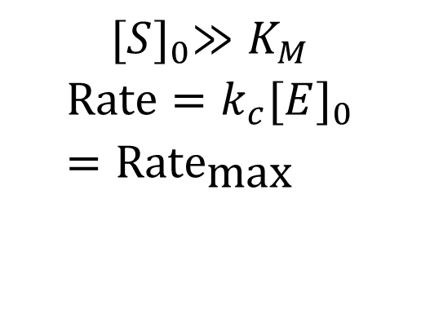
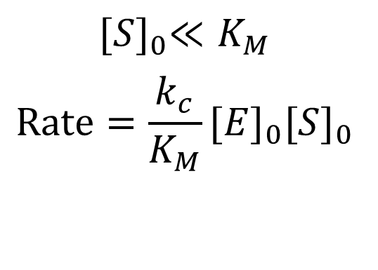
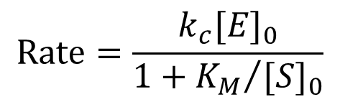
Michaelis-Menten: Limiting Cases
$$\text{Rate}=\frac{k_{c}[{E]}_{0}}{1+{K_{M}}/{{[S]}_{0}}}$$
$${[S]}_{0}≫K_{M}$$
$$\text{Rate}=k_{c}{[E]}_{0}={\text{Rate}}_{\text{max}}$$
$${[S]}_{0}≪K_{M}$$
$$\text{Rate}=\frac{k_{c}}{K_{M}}{[E]}_{0}{[S]}_{0}$$
Rate_{max}
Rate
(Rate_{max})/2
K_{M}
[S]₀

Slide 7
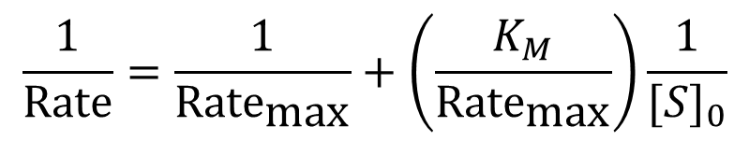
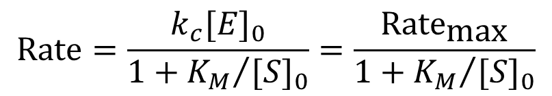
Michaelis-Menten in practice
$$\text{Rate}=\frac{k_{c}[{E]}_{0}}{1+{K_{M}}/{{[S]}_{0}}}=\frac{{\text{Rate}}_{\text{max}}}{1+{K_{M}}/{{[S]}_{0}}}$$
$$\frac{1}{\text{Rate}}=\frac{1}{{\text{Rate}}_{\text{max}}}+\left(\frac{K_{M}}{{\text{Rate}}_{\text{max}}}\right)\frac{1}{{[S]}_{0}}$$
1/Rate
-1/K_{M}
K_{M}/Rate_{max}
1/Rate_{max}
1/[S]₀

Slide 8
chain reactions
CH2PH1 Chemical Kinetics

Slide 9
Chain Reactions
So far we have considered “consecutive” multi-step reactions.
  Reagents undergo a series of reactions (“elementary steps”) one leading on from another, until they make the products.
Chain reactions: molecule of intermediate produced in one step generates a molecule of intermediate in a later step, which then generates another molecule of intermediate, and so on.
Intermediate – “chain carrier ” – often a radical.
Gives rise to more complicated kinetic schemes, usually involving half-powers
e.g. Rate ∝ [A]^{3/2}

Slide 10
Chain reactions: an example
gas phase reaction
    H₂ + Br₂ → 2HBr
Most of the reaction is done by the propagation steps
Br· + H₂ → HBr + H·
H· + Br₂ → HBr + Br·
The radicals H· and Br· are the chain carriers
Other processes add and remove them…
Br₂
HBr
H·
Br·
HBr
H₂

Slide 11
Initiation and termination
The chain carriers are formed by initiation step(s)…
…but removed by termination steps.
Br₂
HBr
Initiation
H·
Br·
Termination
HBr
H₂

Slide 12
Simplified kinetic scheme
Initiation step:
Br₂ + M → 2Br· + M (1)
Propagation steps:
Br· + H₂ → HBr + H· (2)
H· + Br₂ → HBr + Br· (3)
Termination step:
Br· + Br· + M → Br₂ + M (4)
k₁
k₂
k₃
k₄

Slide 13
Worked example
k₁
Br₂ + M → 2Br· + M
Rate₁ = …
k₂
Br· + H₂ → HBr + H·
k₃
H· + Br₂ → HBr + Br·
k₄
Br· + Br· + M → Br₂ + M

Slide 14
Worked example
k₁
Br₂ + M → 2Br· + M
Rate₁ =
k₁ [Br₂][M]
Small because k₁ low (unfavourable)
k₂
Br· + H₂ → HBr + H·
Rate₂ =
k₂ [Br·][H₂]
k₃
H· + Br₂ → HBr + Br·
Rate₃ =
k₃ [H·][Br₂]
Small because [Br·] low
k₄
Br· + Br· + M → Br₂ + M
Rate₄ =
k₄ [Br·]²[M]

Slide 15
Relative rates and concentrations
Propagation rates Rate₂ and Rate₃ are much bigger than Rate₁ and Rate₄
However, the (small) initiation and termination rates Rate₁ and Rate₄ are extremely important and can’t be ignored…

Slide 16
Steady-state approach
Can we produce a rate equation for the formation of HBr in terms of [H₂ ] and [Br₂ ]?
  Assume steady state of both H· and Br·
  Steady-state of Br· → solve to find [Br·]_{SS}
  Steady-state of H· → solve to find [H·]_{SS}
  “Rate” = sum of both processes that make HBr, i.e. steps (2) and (3)
  Substitute in our values of [Br·]_{SS} and [H·]_{SS}

Slide 17
Simplified kinetic scheme
k₁
Br₂ + M → 2Br· + M
(1)
Br₂
HBr
k₂
Br· + H₂ → H· + HBr
(2)
3
k₃
Initiation
H· + Br₂ → Br· + HBr
(3)
1
H·
Br·
k₄
4
Br· + Br· + M → Br₂ + M
(4)
2
Termination
HBr
H₂

Slide 18
We’ll start by only considering the two propagation steps (2) and (3)…
Br₂
HBr
3
k₂
Br· + H₂ → H· + HBr
(2)
H·
Br·
k₃
2
H· + Br₂ → Br· + HBr
(3)
HBr
H₂
From steady-state H· Rate₂ = Rate₃

Slide 19
Initiation and Termination rates also reach steady-state
k₁
Br₂ + M → 2Br· + M
(1)
Br₂
HBr
3
k₂
Initiation
Br· + H₂ → H· + HBr
(2)
1
k₃
H·
Br·
H· + Br₂ → Br· + HBr
(3)
2
4
k₄
Termination
Br· + Br· + M → Br₂ + M
(4)
HBr
H₂
From Steady state Br·
2Rate ₁ + Rate₃ = Rate₂ + 2Rate₄
Rate₂ = Rate₃ (steady state H·) therefore Rate₁ = Rate₄

Slide 20
Finding a rate equation: (going through all of that again, with maths…)
Can we produce a rate equation for the formation of HBr in terms of [H₂ ] and [Br₂ ]?
  Start with steady-state of H· solve to find [H·]_{SS} in terms of [Br·]_{SS}
  Now consider initiation and termination steps, use steady-state of Br· to find [Br·]_{SS}
  Steps (2) and (3) generate products – depend on [Br·]_{SS}
  Substitute into (2) and (3) to get final equation for rate.

Slide 21
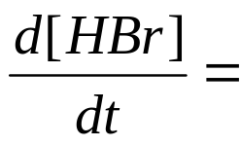

k₁
Br₂ + M → 2Br· + M
Rate₁ =
k₂
Br· + H₂ → H· + HBr
Rate₂ =
k₃
H· + Br₂ → Br· + HBr
Rate₃ =
k₄
Br· + Br· + M → Br₂ + M
Rate₄ =
Overall rate =
Rate₂ + Rate₃
Equation 1

Slide 22


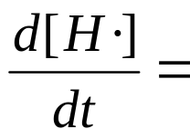



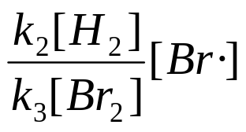
Steady state of H·
Producing H· Step (2) Rate₂ =
Removing H· Step (3) Rate ₃ =
Overall rate of change of H·
Rate₂ - Rate₃
Steady-state:
≈ 0
Equation 2

Slide 23
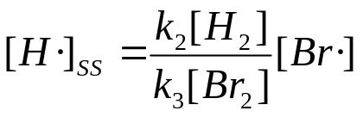
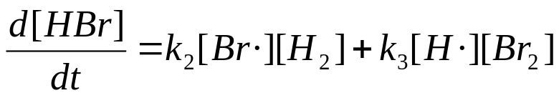
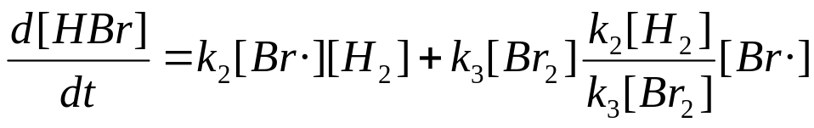


Substitute into one part of the rate equation
Substitute [H·] from equation 2
Overall rate =
into equation 1
Overall rate =
Equation 3

Slide 24
Consider steady-state of Br· with all steps:
k₁
Br₂ + M → 2Br· + M
(1)
k₂
Br· + H₂ → H· + HBr
(2)
k₃
H· + Br₂ → Br· + HBr
(3)
k₄
Br· + Br· + M → Br₂ + M
(4)
Producing Br·?
Removing Br·?

Slide 25
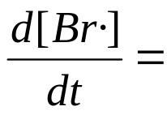

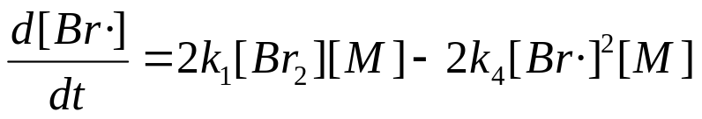

Overall rate of change of Br·
2Rate₁ + Rate₃ – Rate₂ – 2Rate₄
But we already know that Rate₃-Rate₂ = 0 (steady-state of H·)
So
2Rate₁ – 2Rate₄
≈ 0
(Steady State)

Slide 26
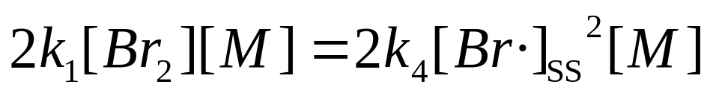
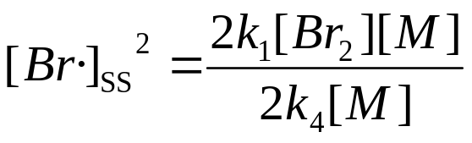
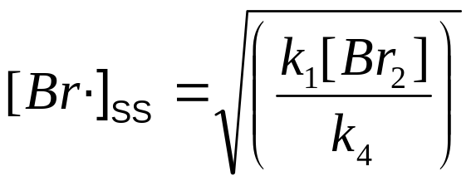
Solve to find [Br·]_{SS}
Equation 4
Substituting back into Equation 3 (for Overall Rate)…

Slide 27
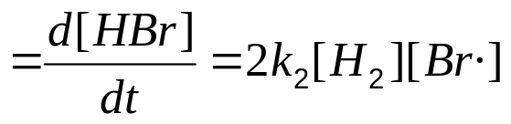
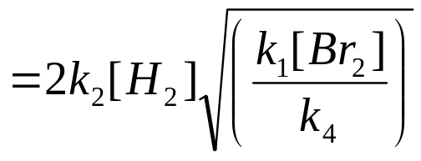
Substitute equation 4
Into equation 3
Overall rate
(Overall) rate = 2k₂(k₁/k₄)^{1/2}[H₂] [Br₂]^{1/2}
This is first-order in H₂, “half-order” in Br₂
Rate laws with “half-powers” are a common feature of chain reactions.

Slide 28
Which other reactions did we ignore, and why?
In theory there could have been other reactions, like
  H₂ + M →2H·+ M another initiation
  H· + H· + M → H₂ + M another termination
  H· + Br· + M → HBr + M another termination
In practice, these are insignificant compared with the initiation and termination steps we have considered

Slide 29
Why ignore the other initiation steps?
Initiation steps are all very endothermic, some more than others.
The more endothermic, the greater the activation barrier.
H-H bond energy 436 kJ/mol
Br-Br bond energy 193 kJ/mol

Slide 30
Why ignore other termination steps?
Termination steps are all very exothermic.
Assume that as soon as two radicals collide (with M), they will react (so, zero activation energy in all cases)
[Br·]>> [H·] so bromine-bromine is most likely radical collision.

Slide 31
Why is [Br·]>> [H·]?
H-H bond stronger than Br-Br
[H·] radical more reactive than [Br·]
Propagation step (2) is endothermic and unfavourable. Propagation step (3) is exothermic, and favourable, and about 10⁸x faster
k₂
Br· + H₂ → H· + HBr
(2)
k₃
H· + Br₂ → Br· + HBr
(3)
See equation 2 (assume [Br₂]=[H₂])
k₂[H₂]<<k₃[Br₂]

Slide 32
Rate constants and complicated rate equations
Chain reactions can have particularly complicated rate equations, with several rate constants
Rate normally expressed as “concentration of stuff”/”some time”, e.g. mM/s, nM/nanosecond…
Simplest case:
rate (concentration/time) = k (???) [A](concentration)
Balance equation – units of k must be 1/time
To compare two rate constants, they must have the same units
What about more complicated cases?

Slide 33

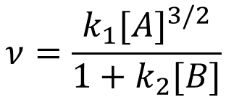
Rate constants and complicated rate equations
$$ν=\frac{k_{1}{[A\text{]}}^{3/2}}{1+k_{2}[B]}$$
$$ν=k{[{\text{CH}}_{3}\text{CHO}\text{]}}^{3/2}$$
M s⁻¹= (units of k₁ × M^{3/2})
(1+ units of k₂ × M)
M s⁻¹= units of k × M^{3/2}
M s⁻¹ / M^{3/2} = units of k
If we add two things together, they MUST have the same units – so k₂ × M must have same units as 1 » units of k₂ = 1/M
M s⁻¹ × M^{-3/2} = units of k
s⁻¹ × M^{-1/2} = units of k
M s⁻¹= units of k₁ × M^{3/2}
s⁻¹ × M^{-1/2} = units of k₁

Slide 34
Learning Outcomes
Today we have:
Introduced the concept of enzyme-catalysed (MM) kinetics
Understood the limiting cases of MM kinetics
Understood the graphical method for solving MM kinetics equations
Introduced the concept of chain reactions
Solved a simple chain reaction equation and described its limiting cases
Reviewed rate constants for more complex rate equations

